Slide 1

Machine Learning
DSBA 6190-U90 | Colby T. Ford, Ph.D.

Slide 2
Overview
Intro to Machine Learning
Machine Learning in the Cloud
Cognitive Services
AutoML
Basics of Algorithms
Regression
Classification
Clustering
Scaling Up with Parallelization
Training
Cross-Validation
Parameter Tuning

Slide 3
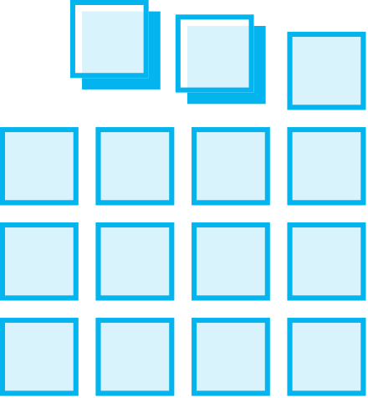
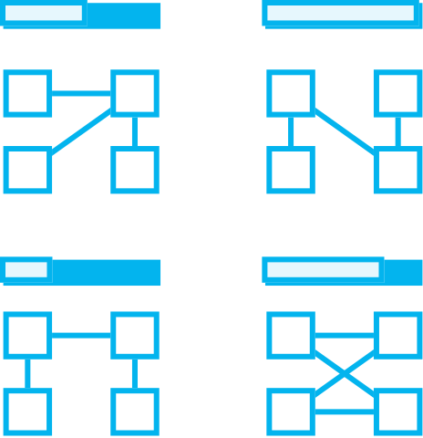


Intro to Machine Learning
Prepare Data
Build & Train
Deploy
Connect to various sources to ingest data
Train with the data to establish a model
Deploy the model and track performance

Slide 4




Machine Learning Options in the Cloud
DSVM
Cognitive Services
Databricks
Machine Learning

Slide 5
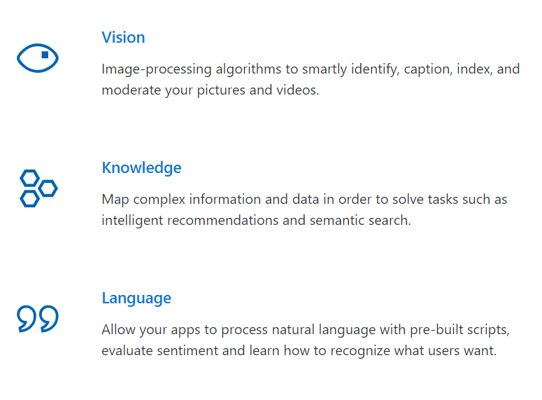
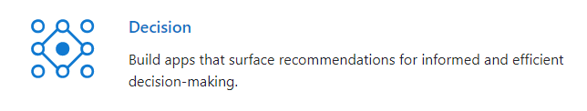
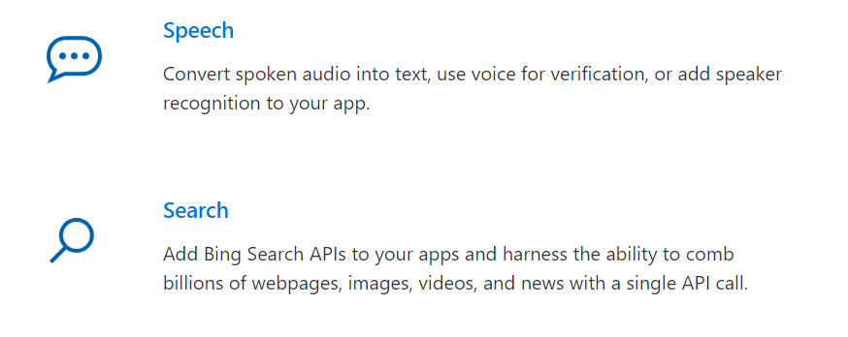
Microsoft Cognitive Services
Infuse your apps, websites and bots with intelligent algorithms to see, hear, speak, understand and interpret your user needs through natural methods of communication.
https://azure.microsoft.com/en-us/services/cognitive-services/

Slide 6
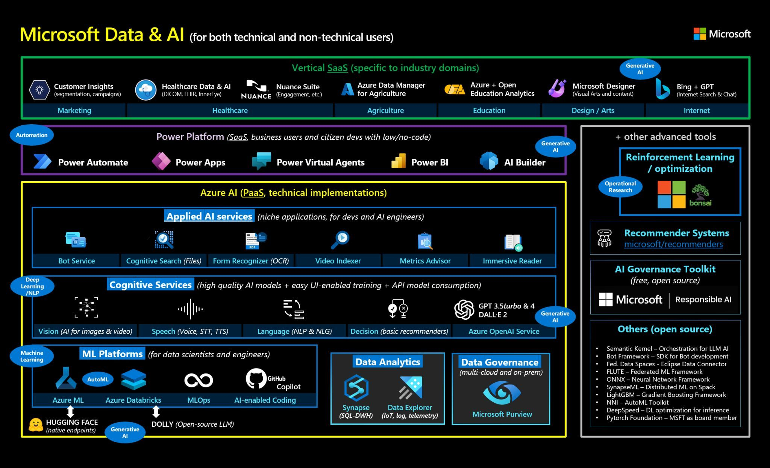

Slide 7
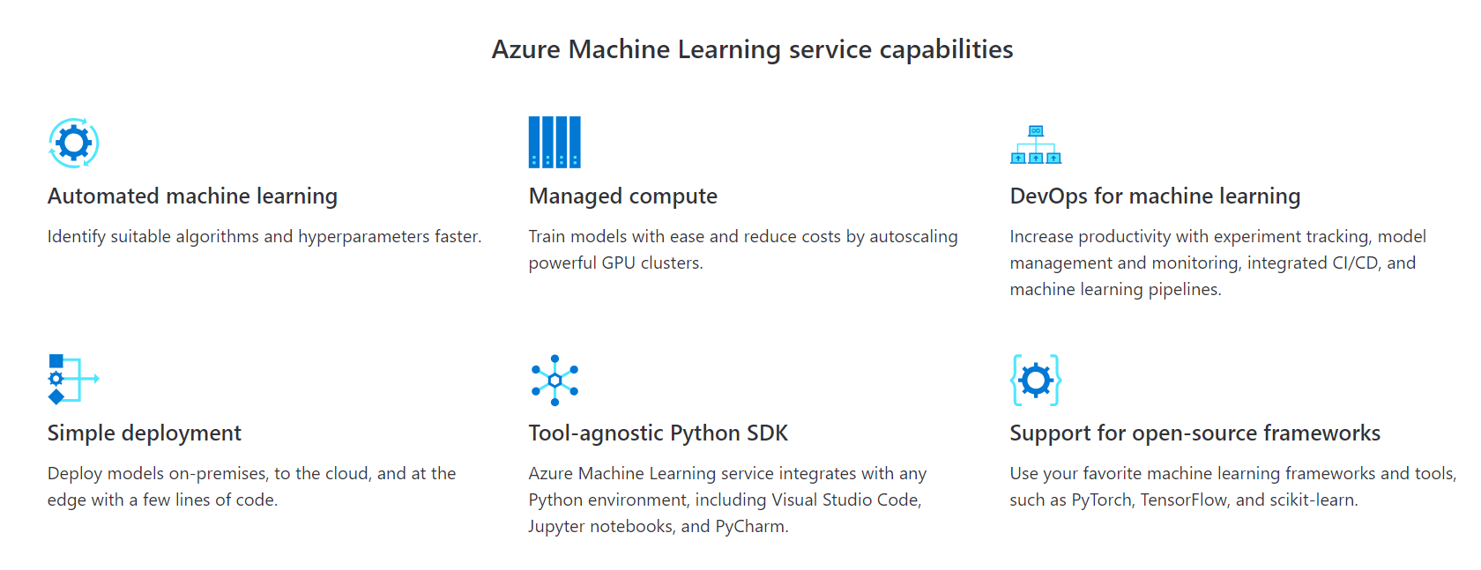
Azure Machine Learning Services
Simplify and accelerate the building, training, and deployment of your machine learning models. Use automated machine learning to identify suitable algorithms and tune hyperparameters faster. Improve productivity and reduce costs with autoscaling compute and DevOps for machine learning. Seamlessly deploy to the cloud and the edge with one click.
https://azure.microsoft.com/en-us/services/machine-learning-service/

Slide 8

ML Lifecycle in Azure Machine Learning
The ML experiment is defined
ML models are trained under the experiment (using a registered dataset) and a Run is defined
The Data Lake is defined as a Datastore
A file from the Datastore is registered as a Data Asset and versioned
The best model is registered and versioned
The registered model is deployed as a webservice

Slide 9
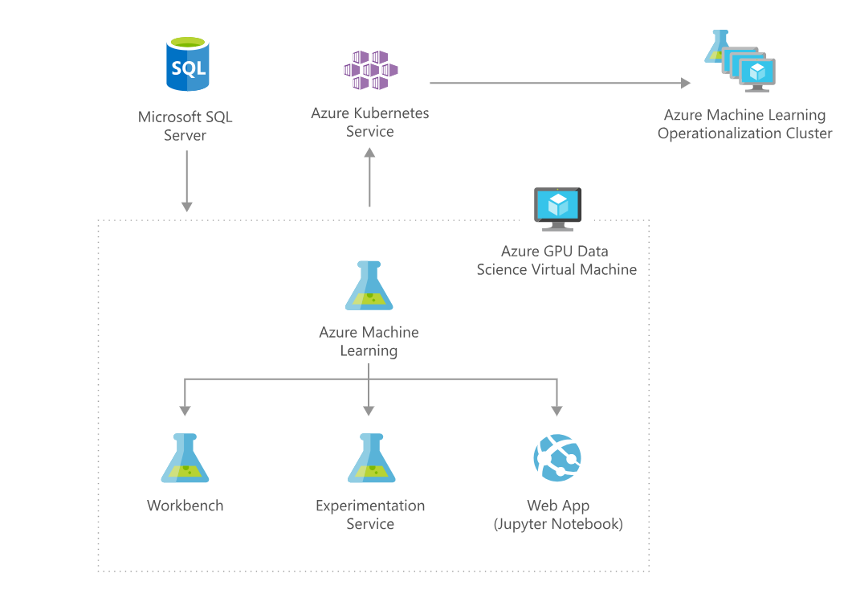
https://azure.microsoft.com/en-us/solutions/architecture/information-discovery-with-deep-learning-and-nlp/

Slide 10
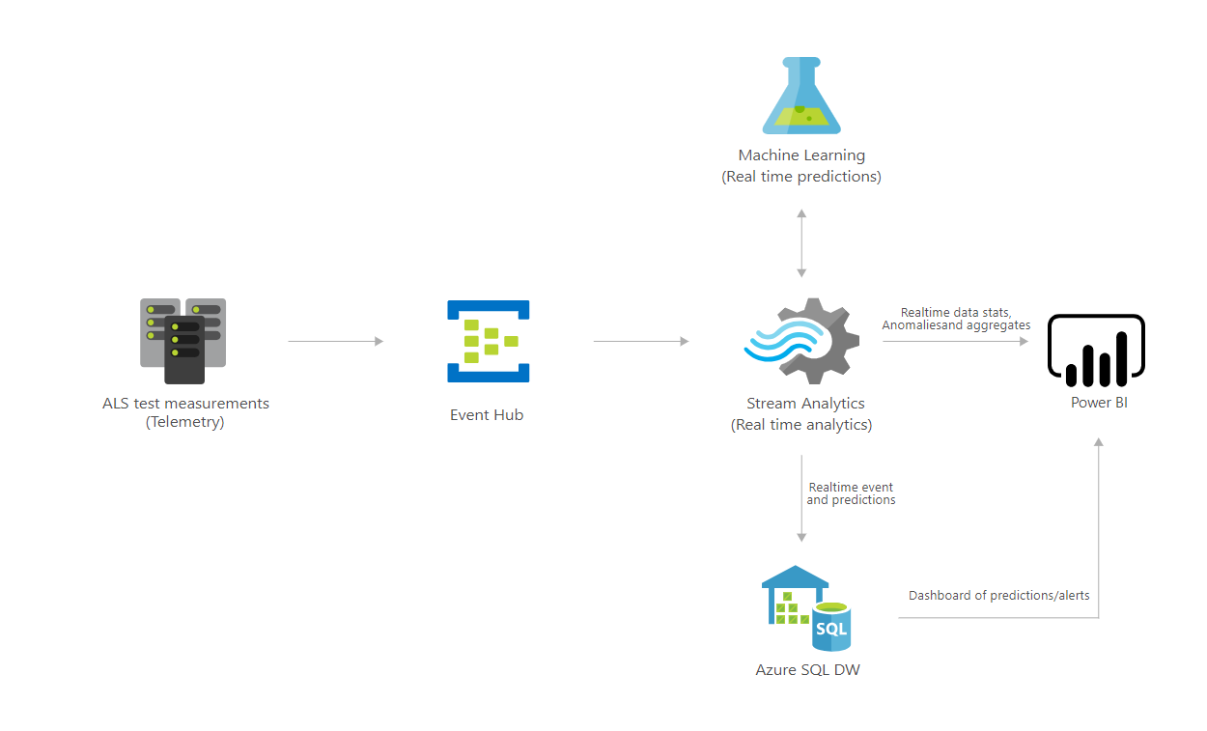
https://azure.microsoft.com/en-us/solutions/architecture/defect-prevention-with-predictive-maintenance/

Slide 11
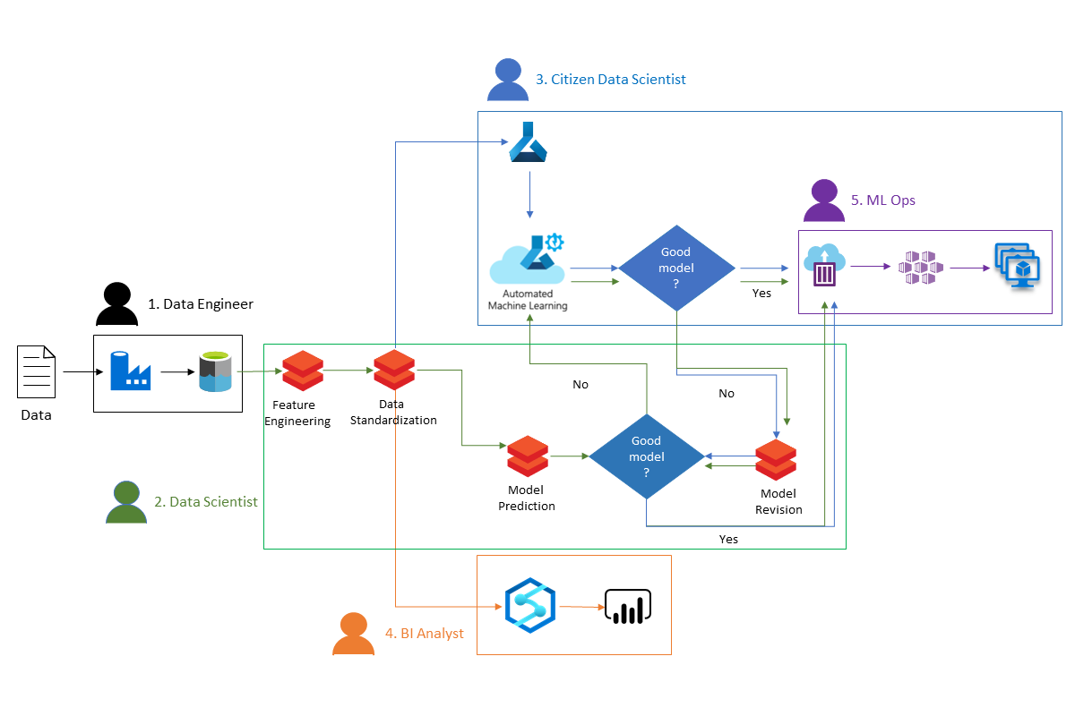
https://docs.microsoft.com/en-us/azure/architecture/example-scenario/ai/predict-hospital-readmissions-machine-learning

Slide 12
Automated Machine Learning (When you’re too lazy busy to do it yourself…)

Slide 13
AutoML
Classification | Regression & Time Series Forecasting
Logistic Regression | Elastic Net
Light GBM | Light GBM
Gradient Boosting | Gradient Boosting
Decision Tree | Decision Tree
K Nearest Neighbors | K Nearest Neighbors
Linear SVC | LARS Lasso
C-Support Vector Classification (SVC) | Stochastic Gradient Descent (SGD)
Random Forest | Random Forest
Extremely Randomized Trees | Extremely Randomized Trees
Xgboost | Xgboost
DNN Classifier | DNN Regressor
DNN Linear Classifier | Linear Regressor
Naive Bayes
Stochastic Gradient Descent (SGD)
Automatically test various algorithms, hyperparameters, and scaling techniques
Three Experiment Types:
Classification
Regression
Forecasting
Steps:
Preprocessing & Scaling
Featurization
Cross-Validation
Ensembling
https://docs.microsoft.com/en-us/azure/machine-learning/service/how-to-configure-auto-train

Slide 14
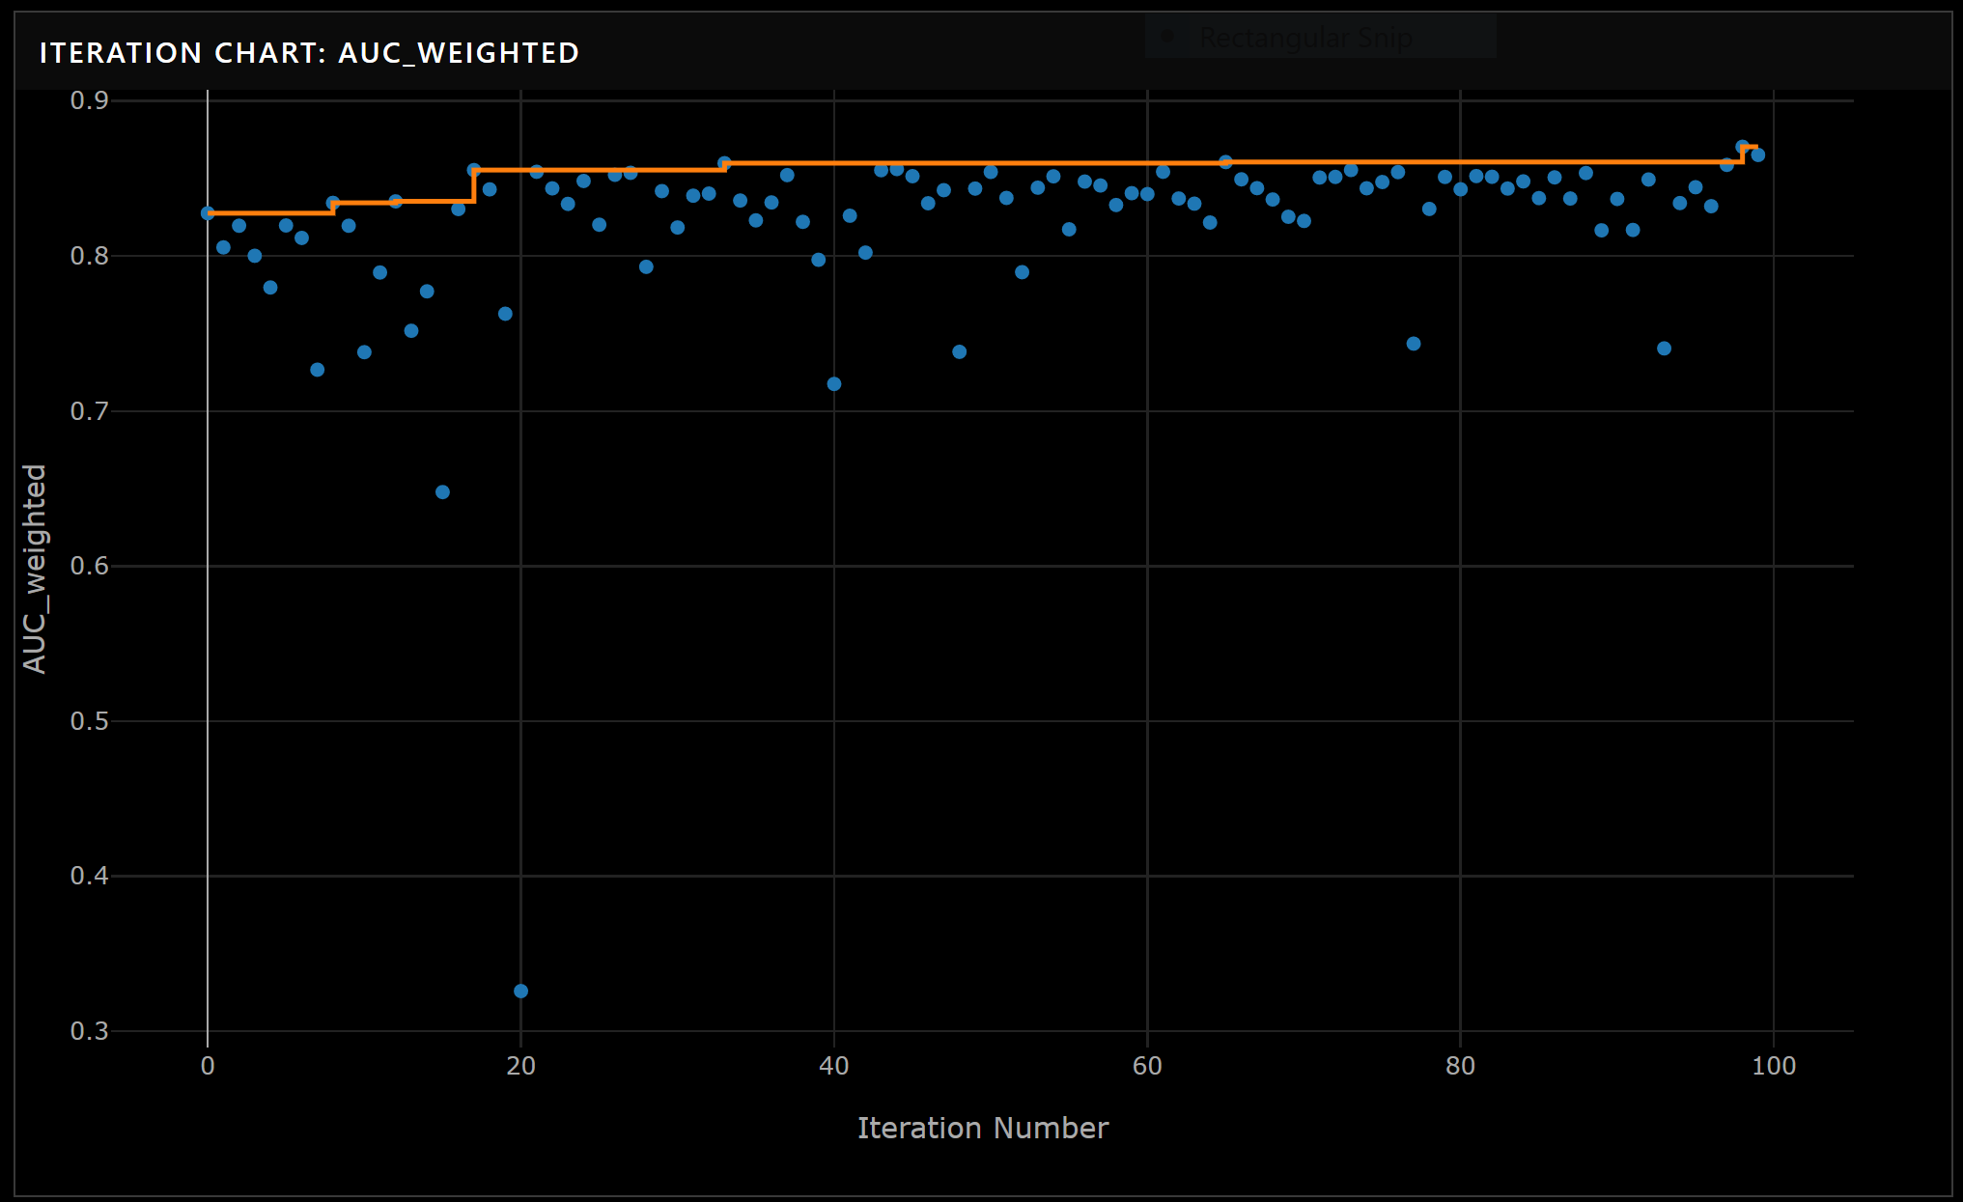
Picking the Best Model
Picks a best model(s) based on a Primary Metric
In Classification Problems:
Accuracy, Weighted AUC, Average Weighted Precision Score, Normalized Macro Recall, Weighted Precision Score
In Regression/Forecasting Problems:
Spearman Correlation, Normalized RMSE, R², Normalized MAE
https://docs.microsoft.com/en-us/azure/machine-learning/service/how-to-understand-automated-ml

Slide 15
Tracking ML Experiments: Two Ways
https://docs.microsoft.com/en-us/azure/machine-learning/how-to-train-scikit-learn
Train Inside the Compute Instance,
Track Externally in Azure ML
Train Externally in a Compute Cluster,
Track Externally in Azure ML
## Connect to Workspace
ws = Workspace.from_config()
## Create Experiment
experiment = Experiment(workspace = ws, name = '<group>_diabetes')
## Create Run
run = experiment.start_logging(outputs=None, snapshot_directory=".", display_name="run_name")
<ML STUFF HERE>
## Log Metrics
run.log('auc_train', 0.85)
run.log('auc_test', 0.82)
run.complete()
## Connect to Workspace
ws = Workspace.from_config()
## Create Experiment
experiment = Experiment(workspace = ws, name = '<group>_diabetes')
<ML STUFF in a train.py SCRIPT>
## Connect to Compute Target (Optional)
training_cluster = ComputeTarget(workspace=ws, name=cluster_name)
## Create Environment for sklearn
sklearn_env = Environment("sklearn-env")
## Create a script config
script_config = ScriptRunConfig(source_directory='.',
script='train.py',
arguments = [],
compute_target=training_cluster,
environment=sklearn_env)
## Submit Experiment
run = experiment.submit(config = script_config)

Slide 16
Machine Learning Deep Dive
Overview of Algorithms:
Regression
Tree-Based Classification
Clustering
Computational Complexity

Slide 17
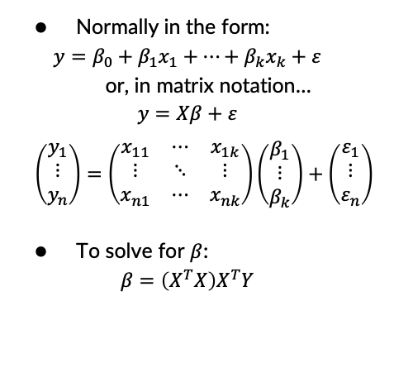
Linear Regression
## Load in data
data(mtcars)
## Define X matrix
X <- as.matrix(cbind(1,
mtcars$cyl,
mtcars$hp))
## Define y matrix
y <- as.matrix(mtcars$mpg)
## Solve for beta_hat
beta_hat <- solve(t(X)%*%X)%*%t(X)%*%y
## Fit the same data using lm
fit <- lm(mpg ~ cyl + hp,
data = mtcars)
fit$coefficients
Normally in the form:
$$y=β_{0}+β_{1}x_{1}+…+β_{k}x_{k}+ε$$
or, in matrix notation…
$$y=Xβ+ε$$
$$\left(\begin{matrix}y_{1} \\ ⋮ \\ y_{n}\end{matrix}\right)=\left(\begin{matrix}x_{11} & ⋯ & x_{1k} \\ ⋮ & ⋱ & ⋮ \\ x_{n1} & ⋯ & x_{nk}\end{matrix}\right)\left(\begin{matrix}β_{1} \\ ⋮ \\ β_{k}\end{matrix}\right)+\left(\begin{matrix}ε_{1} \\ ⋮ \\ ε_{n}\end{matrix}\right)$$
To solve for $β$:
$$β=\left(X^{T}X\right)X^{T}Y$$

Slide 18
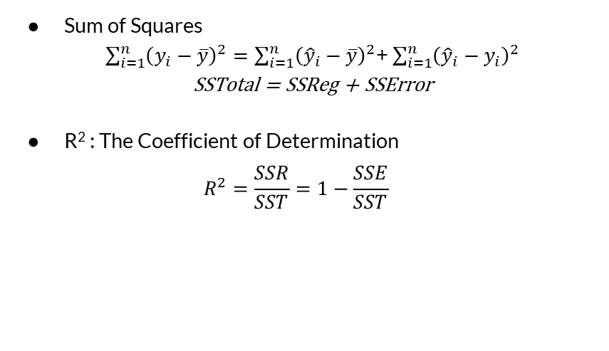
Regression Model Metrics
Sum of Squares
$\sum_{i=1}^{n}{{\left(y_{i}−\overline{y}\right)}^{2}}=\sum_{i=1}^{n}{{\left({\hat{y}}_{i}−\overline{y}\right)}^{2}}$+ $\sum_{i=1}^{n}{{\left({\hat{y}}_{i}−y_{i}\right)}^{2}}$
SSTotal = SSReg + SSError
R² : The Coefficient of Determination
$$R^{2}=\frac{SSR}{SST}=1−\frac{SSE}{SST}$$
Other things to look at:
p-values
RMSE
MAPE

Slide 19
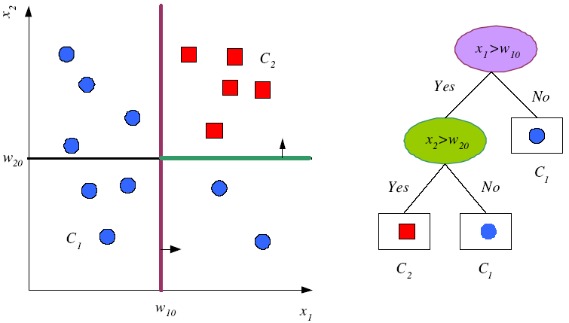
Tree-Based Classification
Decision Trees
Pick the most discriminable factor first, then continue to split
Random Forests
Generate a bunch of random decision trees and vote on the most popular answer
Finishes based on some entropy/purity criterion
https://www.cmpe.boun.edu.tr/~ethem/i2ml3e/3e_v1-0/i2ml3e-chap9.pptx

Slide 20
Divide and Conquer
Internal decision nodes
Univariate: Uses a single attribute, x_{i}
Numeric x_{i} : Binary split : x_{i} > w_{m}
Discrete x_{i} : n-way split for n possible values
Multivariate: Uses all attributes, x
Leaves
Classification: Class labels, or proportions
Regression: Numeric; r average, or local fit
Learning is greedy; find the best split recursively (Breiman et al, 1984; Quinlan, 1986, 1993)

Slide 21
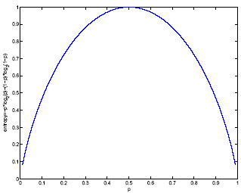
Classification Trees (ID3,CART,C4.5)
For node m, N_{m} instances reach m, N^{i}_{m} belong to C_{i}
Node m is pure if p^{i}_{m} is 0 or 1
Measure of impurity is entropy

Slide 22
Best Split
If node m is pure, generate a leaf and stop, otherwise split and continue recursively
Impurity after split: N_{mj} of N_{m} take branch j. N^{i}_{mj} belong to C_{i}
Find the variable and split that min impurity (among all variables -- and split positions for numeric variables)

Slide 23
Pruning Trees
Remove subtrees for better generalization (decrease variance)
Prepruning: Early stopping
Postpruning: Grow the whole tree then prune subtrees that overfit on the pruning set
Prepruning is faster, postpruning is more accurate (requires a separate pruning set)

Slide 24
“Accuracy is the best indication of a good model.” – Wrong People

Slide 25
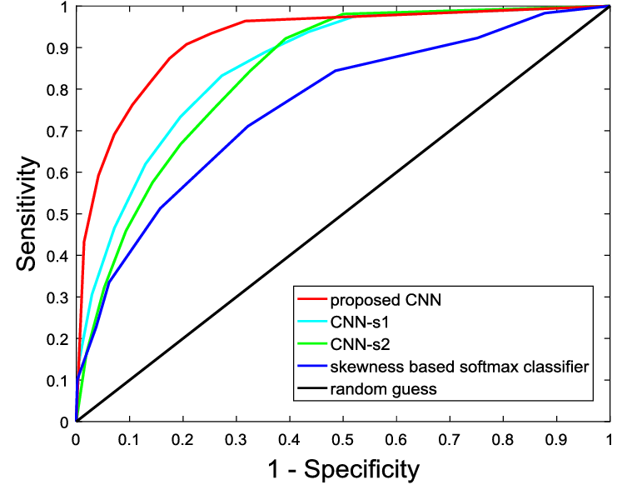
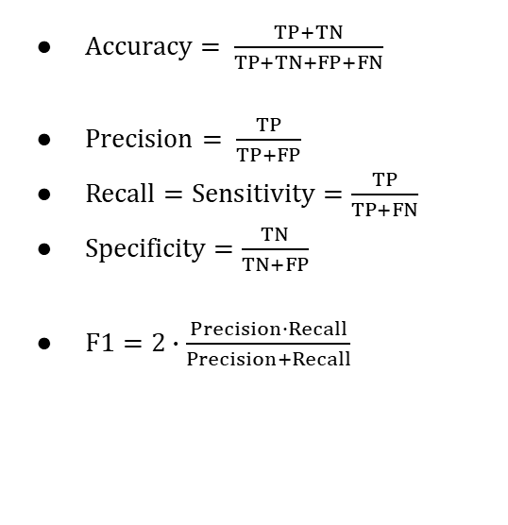
Classification Model Metrics
ROC Curve
A measure of the false positive rate vs. the true positive rate
$Accuracy= \frac{TP+TN}{TP+TN+FP+FN}$
$Precision= \frac{TP}{TP+FP}$
$Recall=Sensitivity=\frac{TP}{TP+FN}$
$Specificity=\frac{TN}{TN+FP}$
$F1=2∙\frac{Precision∙Recall}{Precision+Recall}$
https://www.researchgate.net/figure/ROC-curves-of-different-classifiers-The-ROC-curve-of-an-ideal-classifier-should-be_fig5_319939197

Slide 26
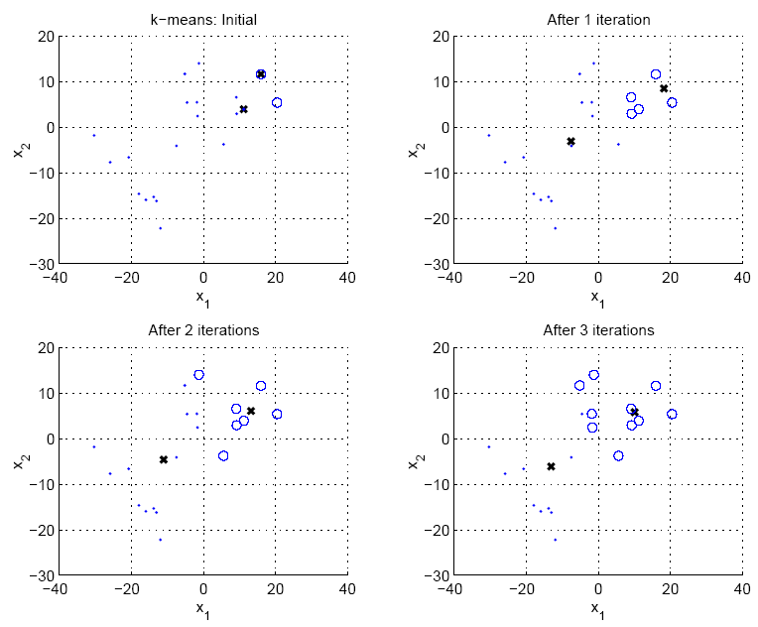
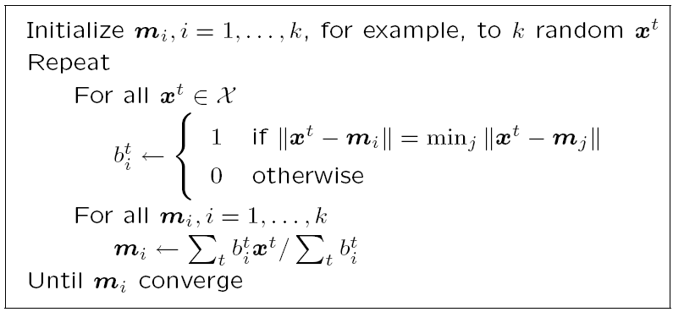
Clustering
Multiple methods:
Agglomerative – “Bottom-Up”
UPGMA
Divisive – “Top-Down”
k-Means
Based on some distance metric and some linkage criteria.
https://www.cmpe.boun.edu.tr/~ethem/i2ml3e/3e_v1-0/i2ml3e-chap7.pptx

Slide 27
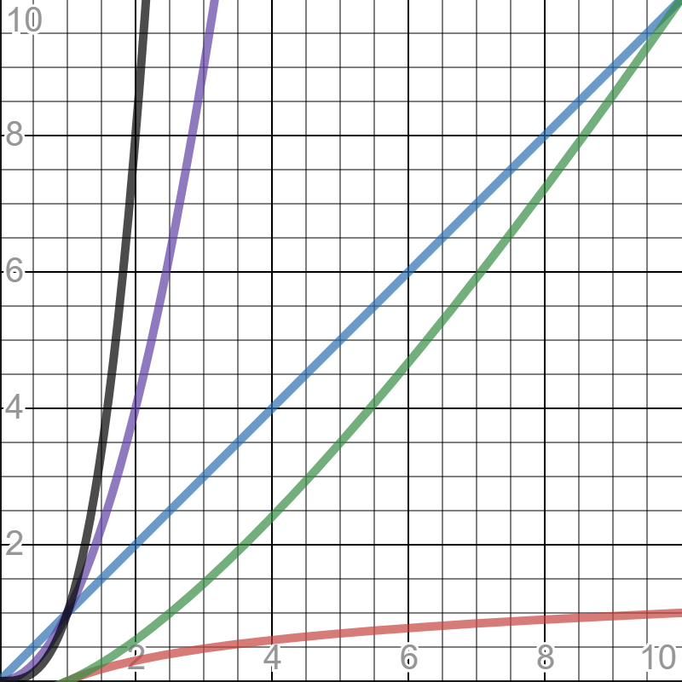
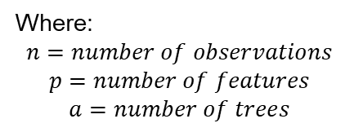
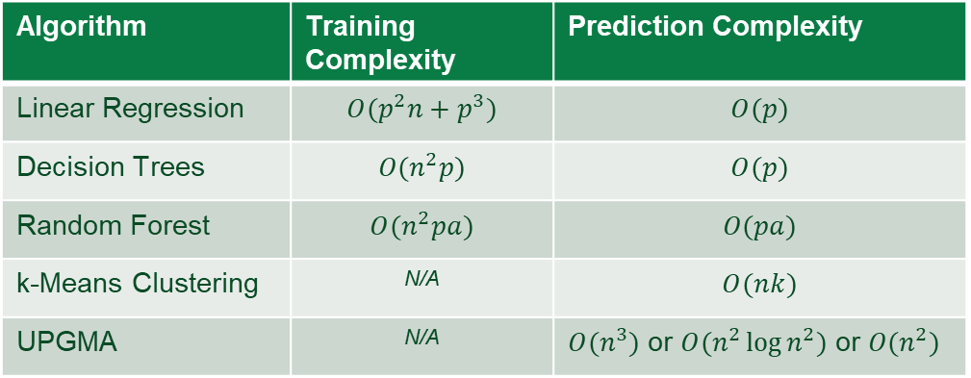
Computational Complexity
Algorithm | Training Complexity | Prediction Complexity
Linear Regression | $$O(p^{2}n+p^{3})$$ | $$O(p)$$
Decision Trees | $$O(n^{2}p)$$ | $$O(p)$$
Random Forest | $$O(n^{2}pa)$$ | $$O(pa)$$
k-Means Clustering | N/A | $$O(nk)$$
UPGMA | N/A | $O(n^{3})$ or $O(n^{2}\log{n^{2}})$ or $O(n^{2})$
A measure of inherent difficulty in completing a computational task
In other words, if I increase the number of input points (either variables, observations, or parameters), by what factor does the computational time increase?
Where:
$$n=number of observations$$
$$p=number of features$$
$$a=number of trees$$
https://www.thekerneltrip.com/machine/learning/computational-complexity-learning-algorithms/

Slide 28
Just Keep Modelin’
Parameter Tuning
Grid Search
Regularization
Gradient Decent
Cross-Validation
k-Fold CV
LpOCV/LOOCV
Intro to Training Parallelization
Proving the model is valid in more scenarios than just on the training data.

Slide 29
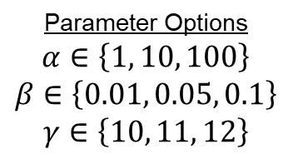
Grid Search
Parameter Grid
# | 𝛼 | 𝛽 | 𝛾
1 | 1 | 0.01 | 10
2 | 10 | 0.01 | 10
3 | 100 | 0.01 | 10
4 | 1 | 0.05 | 10
5 | 10 | 0.05 | 10
6 | 100 | 0.05 | 10
7 | 1 | 0.10 | 10
8 | 10 | 0.10 | 10
9 | 100 | 0.10 | 10
10 | 1 | 0.01 | 11
11 | 10 | 0.01 | 11
12 | 100 | 0.01 | 11
13 | 1 | 0.05 | 11
14 | 10 | 0.05 | 11
15 | 100 | 0.05 | 11
16 | 1 | 0.10 | 11
17 | 10 | 0.10 | 11
18 | 100 | 0.10 | 11
19 | 1 | 0.01 | 12
20 | 10 | 0.01 | 12
21 | 100 | 0.01 | 12
22 | 1 | 0.05 | 12
23 | 10 | 0.05 | 12
24 | 100 | 0.05 | 12
25 | 1 | 0.10 | 12
26 | 10 | 0.10 | 12
27 | 100 | 0.10 | 12
Most traditional way of parameter sweeping is to build a grid of multiple parameter options
Parameters can be discrete or continuous
Must pick a finite set of reasonable options
The locally optimal set is the combination of parameters that minimize or maximize a criterion. (Such as RMSE, R², AUC, etc.)
Parameter Options
$$α∈\left\{1, 10, 100\right\}$$
$$β∈\left\{0.01, 0.05, 0.1\right\}$$
$$γ∈\left\{10, 11, 12\right\}$$
## in R
alpha <- c(1, 10, 100)
beta <- c(0.01, 0.05, 0.1)
gamma <- c(10, 11, 12)
grid <- expand.grid(alpha, beta, gamma)

Slide 30
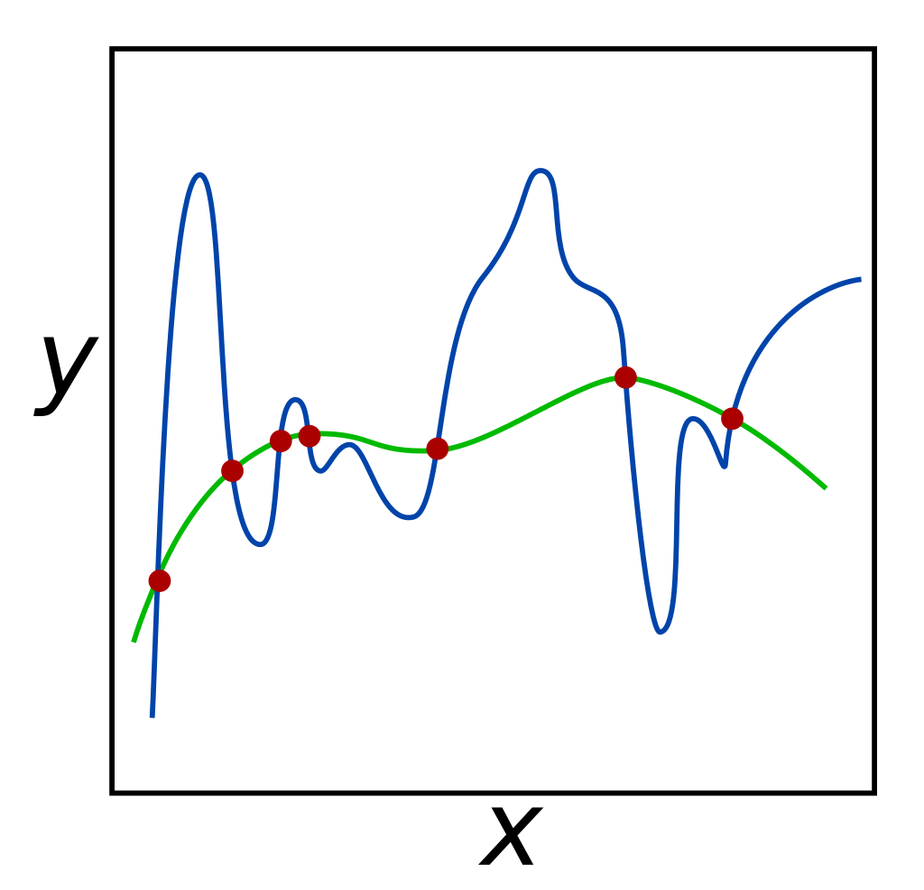
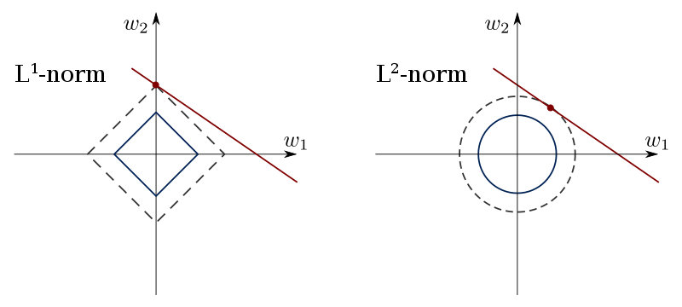

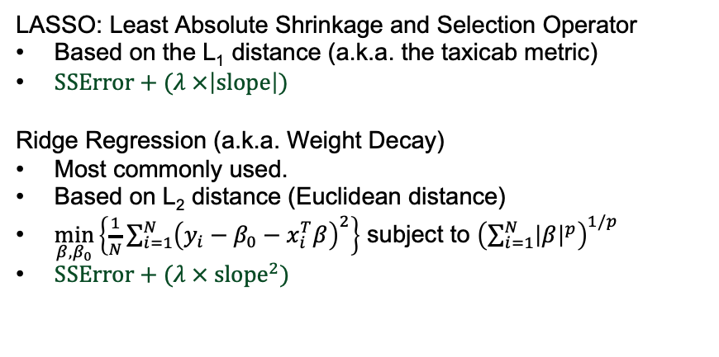
Regularization
LASSO: Least Absolute Shrinkage and Selection Operator
Based on the L₁ distance (a.k.a. the taxicab metric)
$SSError+(λ ×\left|slope\right|)$
Ridge Regression (a.k.a. Weight Decay)
Most commonly used.
Based on L₂ distance (Euclidean distance)
$\min_{β,β_{0}}\left\{\frac{1}{N}\sum_{i=1}^{N}{{\left(y_{i}−β_{0}−x_{i}^{T}β\right)}^{2}}\right\}$ subject to ${\left(\sum_{i=1}^{N}{{\left|β\right|}^{p}}\right)}^{1/p}$
$SSError+(λ ×{ slope}^{2})$
Adding in information to prevent overfitting of the model to training data.
Usually denoted by $α$ or $λ_{k}$
In combination, can be referred to as an Elastic Net
Other Papers:
Elastic Nets
LASSO
Ridge Regression
L₁ vs L₂ Regularization
https://commons.wikimedia.org/wiki/File:Regularization.svg
https://en.wikipedia.org/wiki/File:L1_and_L2_balls.svg

Slide 31
Common Parameters to Sweep
https://scikit-learn.org/stable/modules/generated/sklearn.tree.DecisionTreeClassifier.html
https://spark.apache.org/docs/2.2.0/mllib-decision-tree.html
https://scikit-learn.org/stable/modules/generated/sklearn.linear_model.LinearRegression.html#sklearn.linear_model.LinearRegression
https://spark.apache.org/docs/2.2.0/ml-classification-regression.html#regression
https://spark.apache.org/docs/2.2.0/mllib-naive-bayes.html#naive-bayes-sparkmllib
Trees:
Max Depth
Max Bins
Number of Trees (in a Random Forest)
Max Splits
Max Features
Min Samples per Leaf
Max Leaf Nodes
Min Impurity Decrease
Min Impurity to Split
… and more
Regression and Other Algorithms:
Regularization
Elastic Net
Maximum Iterations
Smoothing (in Naïve Bayes)
… and more

Slide 32
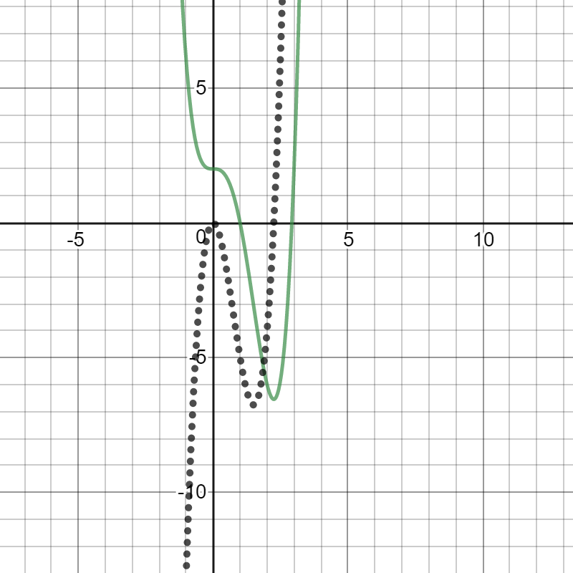

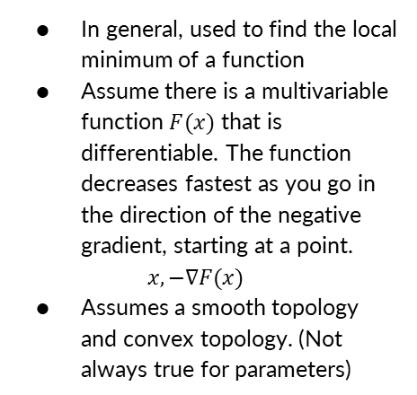
Gradient Descent
## Parameters
alpha = 0.001 #Stepsize
iter = 500 #Iterations
# Define the objective function f(x) = x^4 - 3*x^3 + 2
objFun = function(x){
return(x^4 - 3*x^3 + 2)
}
# Define the gradient of f(x) = x^4 - 3*x^3 + 2
gradient = function(x){
return((4*x^3) - (9*x^2))
}
# Randomly initialize a value to x
set.seed(1337)
x = floor(runif(1, 0, 10))
# Create a vector to contain all x's for all steps
values = numeric(iter)
# Loop for Gradient Descent method to find the minimum
for(i in seq_len(iter)){
x = x - alpha*gradient(x)
values[i] = x
print(x)
}
# Output
print(paste("The minimum of f(x) is ",
objFun(x),
" at position x = ",
x,
sep = ""))
plot(values,
type = "l")
In general, used to find the local minimum of a function
Assume there is a multivariable function $F(x)$ that is differentiable. The function decreases fastest as you go in the direction of the negative gradient, starting at a point.
$$x, −∇F(x)$$
Assumes a smooth topology and convex topology. (Not always true for parameters)
$$f\left(x\right)=x^{4}−3x^{3}+2$$
$$f^{′}\left(x\right)=4x^{3}−9x^{2}$$

Slide 33
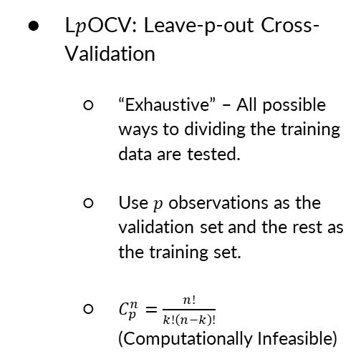
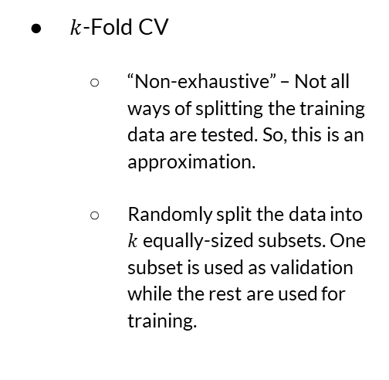
Cross Validation
$k$-Fold CV
“Non-exhaustive” – Not all ways of splitting the training data are tested. So, this is an approximation.
Randomly split the data into $k$ equally-sized subsets. One subset is used as validation while the rest are used for training.
L$p$OCV: Leave-p-out Cross-Validation
“Exhaustive” – All possible ways to dividing the training data are tested.
Use $p$ observations as the validation set and the rest as the training set.
$C_{p}^{n}=\frac{n!}{k!\left(n−k\right)!}$ (Computationally Infeasible)

Slide 34
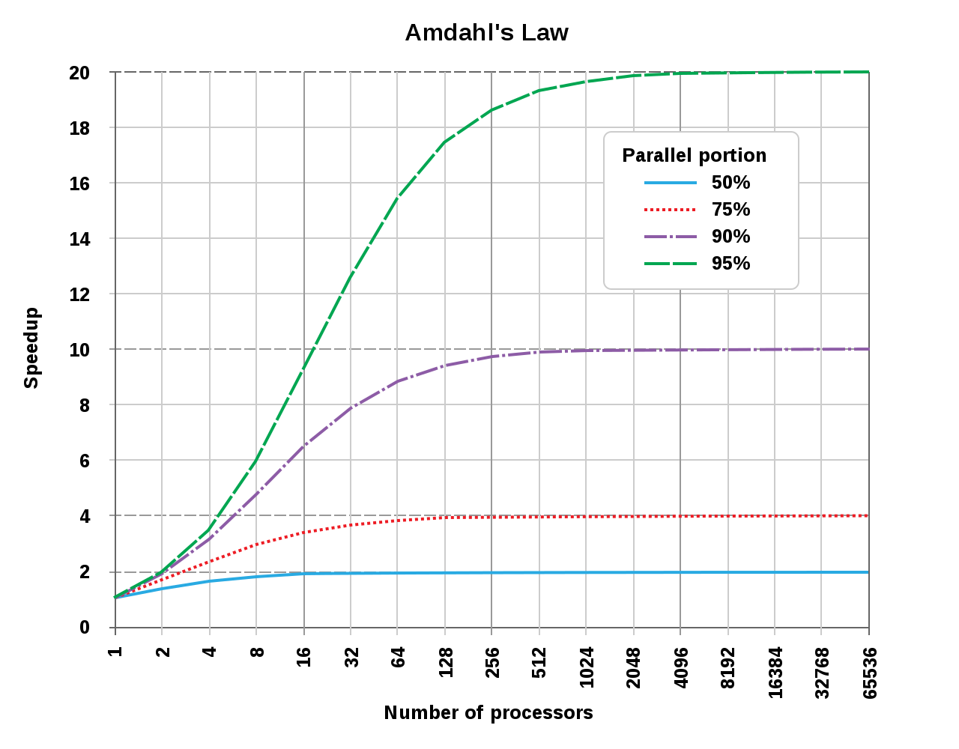
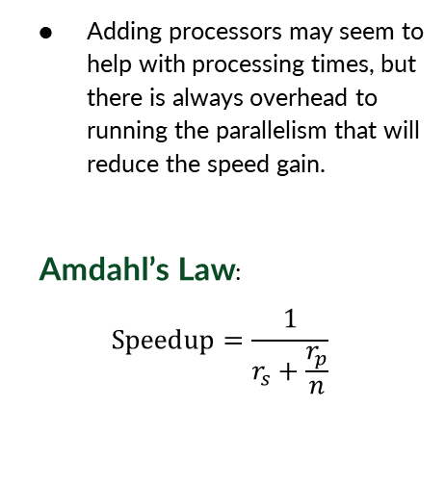
When to parallelize?
Adding processors may seem to help with processing times, but there is always overhead to running the parallelism that will reduce the speed gain.
Amdahl’s Law:
$$Speedup=\frac{1}{r_{s}+\frac{r_{p}}{n}}$$
r_{s} = Ratio of program that is sequential
r_{p} = Ratio of program that is parallel
http://www-inst.eecs.berkeley.edu/~n252/paper/Amdahl.pdf

Slide 35
Training Parallelization - Packages
In R
parallel, foreach, doParallel, doMC, doSNOW, doMPI
https://cran.r-project.org/web/views/HighPerformanceComputing.html
Example: https://nceas.github.io/oss-lessons/parallel-computing-in-r/parallel-computing-in-r.html
In Python
multiprocessing, Dask, Numba, etc.
https://wiki.python.org/moin/ParallelProcessing
Example: https://nbviewer.jupyter.org/gist/ogrisel/5115540/Model%20Selection%20for%20the%20Nystroem%20Method.ipynb

Slide 36
Cluster Architecture
Node
Core
Processor
Processor
Core
Task₅
Task₆
Core
Task…
Task_{n}
Core
Node
Processor₁
Core
Task₁
Core
Task₂
Processor
Core
Task₃
Core
Task₄
Cluster

Slide 37
caret Example
## Stochastic Gradient Boosting
##
## 157 samples
## 60 predictor
## 2 classes: 'M', 'R'
##
## No pre-processing
## Resampling: Cross-Validated (10 fold, repeated 10 times)
## Summary of sample sizes: 141, 142, 141, 142, 141, 142, ...
## Resampling results across tuning parameters:
##
## interaction.depth n.trees Accuracy Kappa
## 1 50 0.78 0.56
## 1 100 0.81 0.61
## 1 150 0.82 0.63
## 1 200 0.83 0.65
## 1 250 0.82 0.65
## 1 300 0.83 0.65
## : : : :
## 9 1350 0.85 0.69
## 9 1400 0.85 0.69
## 9 1450 0.85 0.69
## 9 1500 0.85 0.69
##
## Tuning parameter 'shrinkage' was held constant at a value of 0.1
##
## Tuning parameter 'n.minobsinnode' was held constant at a value of 20
## Accuracy was used to select the optimal model using the largest value.
## The final values used for the model were n.trees = 1200,
## interaction.depth = 9, shrinkage = 0.1 and n.minobsinnode = 20.
fitControl <- trainControl(## 10-fold CV
method = "repeatedcv",
number = 10,
## repeated ten times
repeats = 10)
gbmGrid <- expand.grid(interaction.depth = c(1, 5, 9),
n.trees = (1:30)*50,
shrinkage = 0.1,
n.minobsinnode = 20)
gbmFit <- train(Class ~ ., data = training,
method = "gbm",
trControl = fitControl,
verbose = FALSE,
tuneGrid = gbmGrid)
https://topepo.github.io/caret/model-training-and-tuning.html

